Slide 1
Tier 2 Anxiety Curriculum: A Brief overview

Slide 2
Agenda
What This Will Cover:
Where to access/how to use the materials
Key highlights of the curricula (including its foundation on brain science)
Discussion of key aspects within the curricula (particularly for grades 6-12)
Considering group dynamics (which applies to any Tier 2 group intervention)
What This Will Not Cover:*
Step-by-step review of each session
In-depth review of the handouts
*Contact Terrace Metrics to schedule additional workshop on these topics

Slide 3
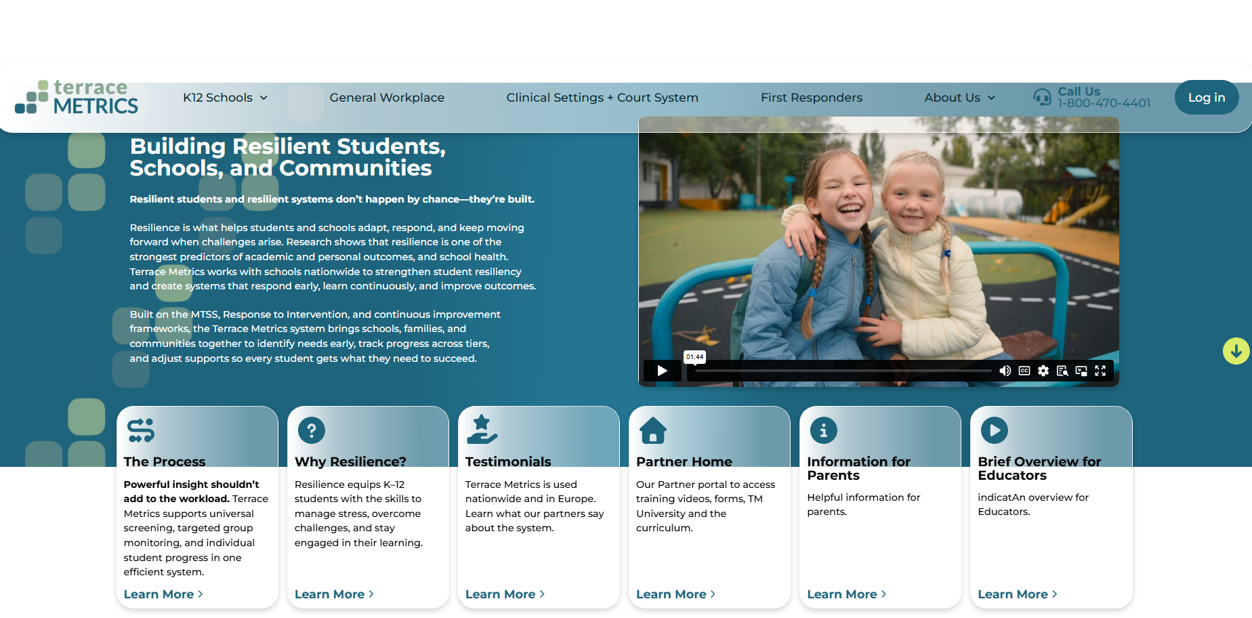
Accessing the Curriculum

Slide 4
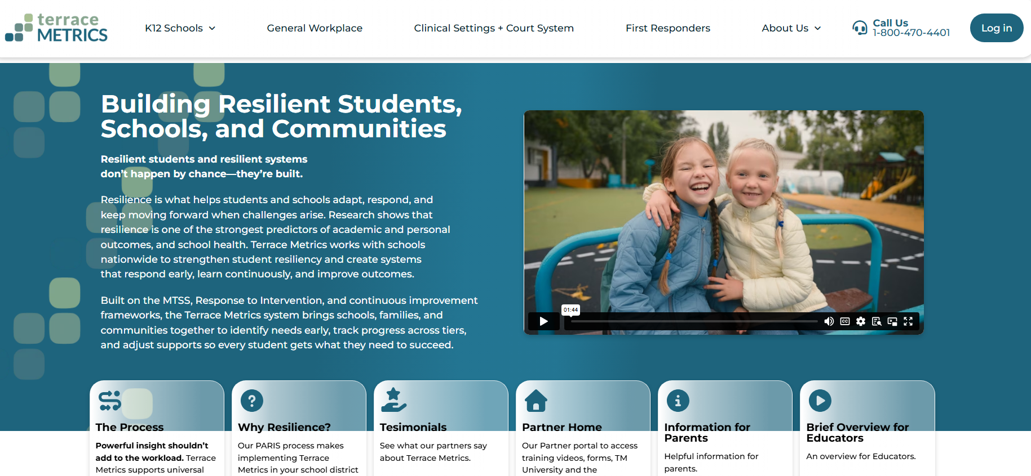
Accessing the Curriculum
Reminder:
If you have not done so last Fall, you will need to create an account

Slide 5
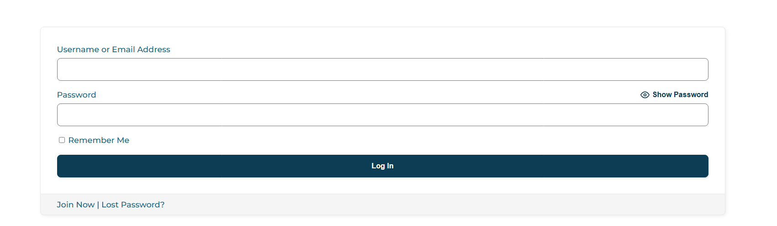

Slide 6
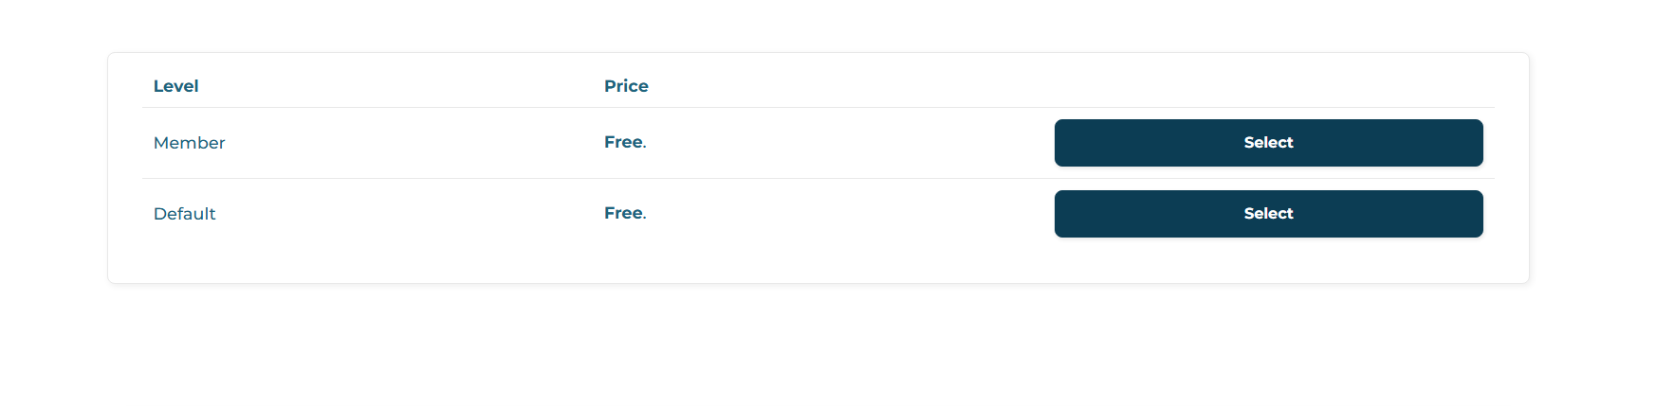
Click On Either Button

Slide 7
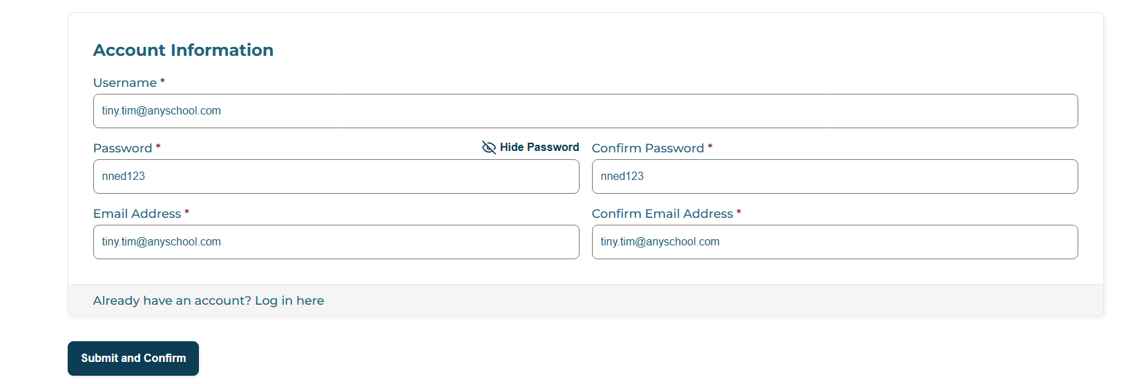
Don’t Forget to Click This Button

Slide 8
Once an account is established…

Slide 9



Slide 10


Slide 11


Slide 12
K-5 Curriculum
Contains a Handbook and a Sample Parent/Guardian Consent Form (in needed)
Contains all the Materials for 5 Modules (a separate button for each module)
Worksheets within each Module are Separated Into Grades K-3 and Grades 4-5
  Most worksheets are the same, but how young children record their responses are different

Slide 13

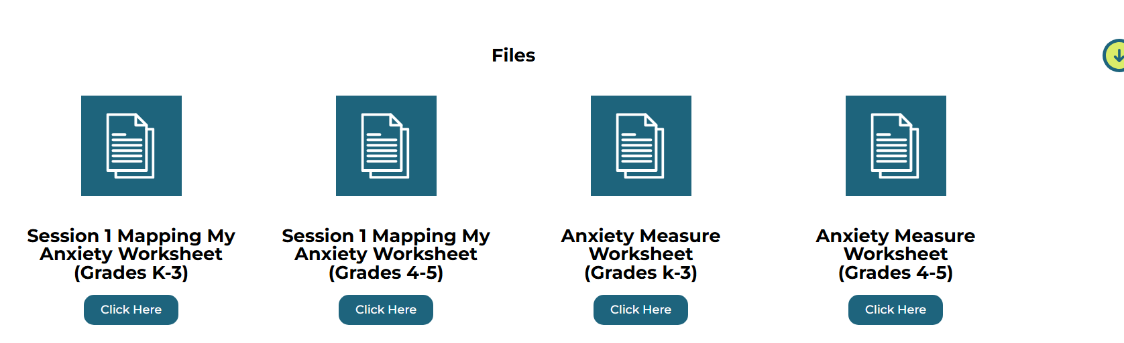
K-5 Curriculum
Each Module Contains a PowerPoint Presentation and Scripts
Note: The scripts are also found in the notes section within each slide

Slide 14
6-12 Curriculum
Contains a Handbook and a Sample Parent/Guardian Consent Form (in needed)
Contains all the Materials for 6 Modules (a separate button for each module)
Worksheets Within Each Module are Not Separated by Grade (use the materials regardless of grade level)

Slide 15
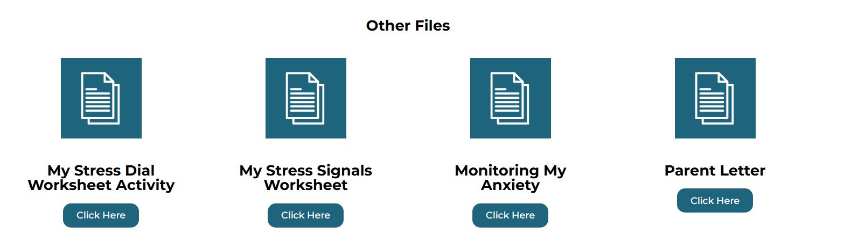
6-12 Curriculum
Like the K-5 Module, Each Grades 6-12 Module Contains a PowerPoint Presentation and Scripts
Note: The scripts are also found in the notes section within each slide

Slide 16
Quick Note on the curriculum
The Curricula Across Grade Levels is Based on Sequenced Stages:
  Understanding what anxiety feels like
  Connecting what they feel to what they believe when they are anxious
  Self-calming/thought-balancing strategies
  Application of learned tools in real-life situations
  Each Module Follows a Predictable Structure:
  Quick check-in before beginning
  Review of previous assignment
  Teaching a new skill/in-group practice
  Closing and new assignment

Slide 17
Quick Note on the curriculum
Regardless of Age, Each Module:
  Designed to take 20-30 minutes
  Does not presume previous training in group counseling techniques or cognitive-behavioral framework
    The manual contains several resources for those who wish to learn more
  Does not require exposure to sources of anxiety
  Focuses on adding to what was learned in the previous module (do not skip modules)
  Emphasizes skill building (students are expected to practice the skills they learn outside of group)
  Emphasizes homework compliance

Slide 18
Quick Note on the curriculum
K-3 Curriculum:
  Focuses on having young children understand the basics of anxiety
  Takes into account the cognitive development of the child (simple language and concepts, easy to follow worksheets)
  Not tied to the Terrace Metrics’ Tier 3 curriculum (Coping Cat®); labels used are incidental (worry cat/calm cat)
  Aim is to have the child practice simple skills, with most skills based on identifying how they feel and self-calming strategies

Slide 19
Quick Note on the curriculum
6-12 Curriculum:
  With increased cognitive capacity, adolescents are guided to understand the sources of their anxiety and practice self-calming and thought-balancing strategies.
  Directly tied to the Terrace Metrics’ Tier 3 curriculum (AID®); same labels are used across Tiers
  Especially for older students, greater emphasis on anxiety thoughts and rebalancing

Slide 20
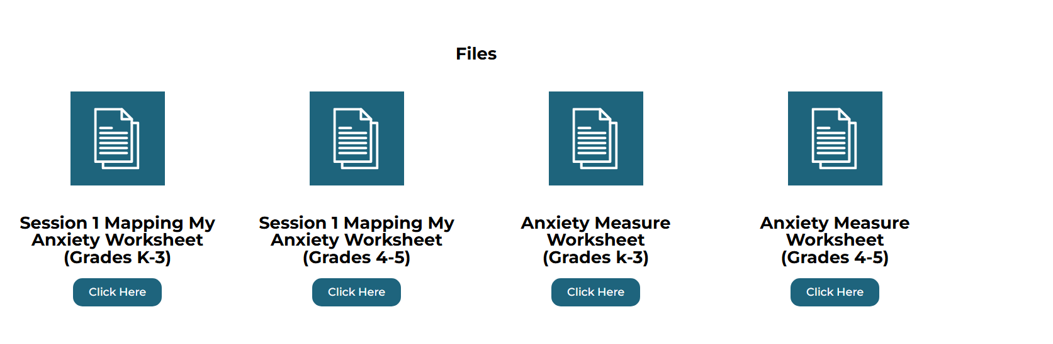
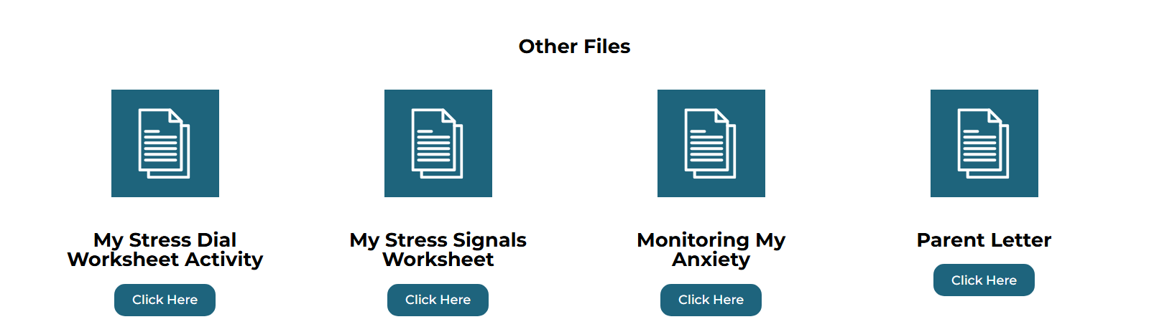
Quick Note on the curriculum
  Regardless of grade, emphasis on weekly RTI monitoring (using the relevant anxiety outcome measure)
  Consult the manual for scoring procedures

Slide 21
Foundations of the curricula

Slide 22
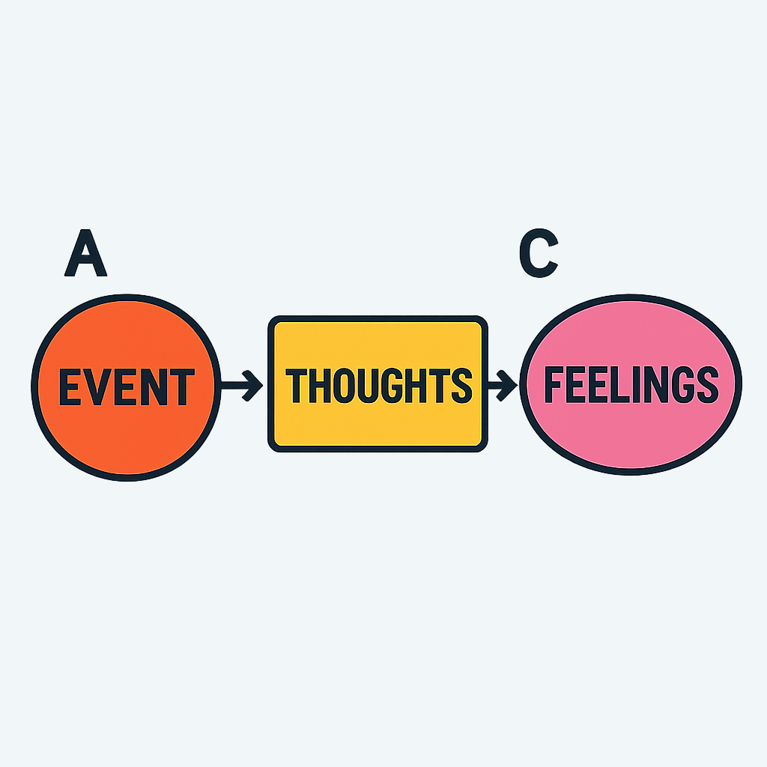

The Behavior Chain
B
Notes:
“That’s right — the missing piece is B, which stands for the belief or thought that happens between the event and the feeling.”
“In other words, what we feel is a result of what we tell ourselves.
When we change our thoughts, we can change how we feel — and when we change how we feel, our behaviors start to change too.”
“So it’s not just what happens that makes us feel anxious or upset — it’s how we interpret the event.”
(Pause for emphasis and connection.)

Slide 23
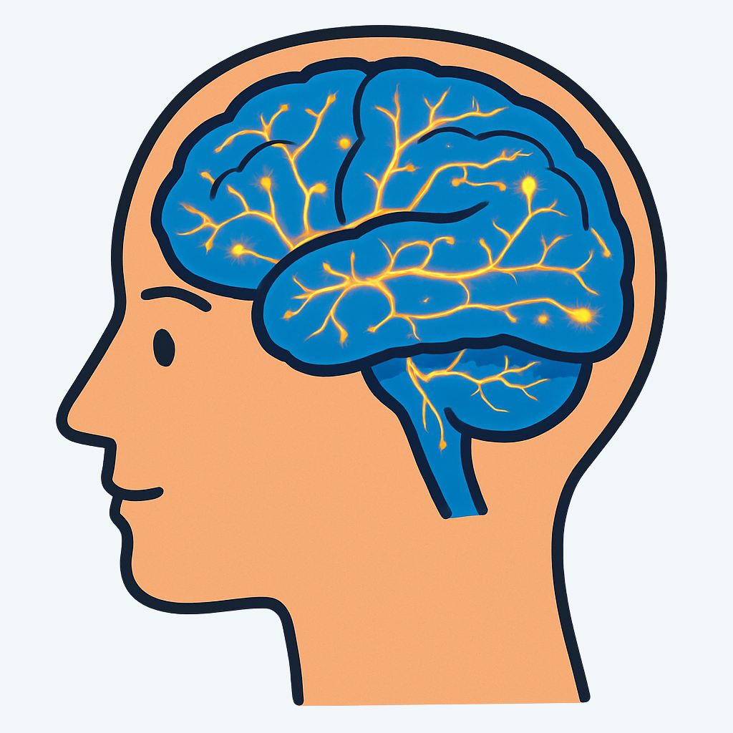
brain Science
Notes:
“Today we’re going to look at what actually happens in your brain when you feel anxious or distressed.
You’ve probably noticed that sometimes anxiety can make your heart race, your stomach twist, or your mind go blank.
That’s not your imagination — that’s your brain and body working together to keep you safe.
Let’s break it down.”
(hand out the Understanding How the Brain and Anxiety Work Together sheet)

Slide 24

Notes:
“Let’s start with the Brain Stem — this is the oldest part of your brain, and it has one main job: to keep you alive.”
“It controls things you don’t even have to think about — like your breathing, heartbeat, and body temperature. It’s basically your brain’s autopilot system.”
“Even though you’re not aware of it, your brain stem is constantly on the lookout for danger. It’s like a security guard that never sleeps. For example, think about a time when something suddenly moved in the corner of your eye, and you instantly looked toward it. That was your brain stem kicking in to make sure you were safe.”
“When your brain senses something that might be a threat — even something small, like a pop quiz, a big game, or an argument — your brain stem reacts instantly. It gets your body ready to fight, run away, or freeze.”
“That’s your body’s way of saying, ‘I’ve got to protect you!’

Slide 25
Notes:
Even though it’s trying to help, sometimes it reacts too quickly — and that’s when stress or anxiety can show up. When your brain stem detects something that might be a threat, it sends a message to another part of your brain — a small but powerful structure called the Amygdala.
You can think of the amygdala as your brain’s smoke alarm.
Its job is to warn you when something might be dangerous — even if it turns out to be a false alarm.”
“When your amygdala receives a message from your brainstem, it sends a message to your body that says,
‘Alert! Something’s wrong!’
Your heart starts beating faster, your breathing changes, and your muscles tense up — your body is getting ready to react.”
“This alarm system is super helpful when there’s real danger — like if you almost step on a snake or need to move fast to stay safe.”
“But sometimes, the amygdala sets off that alarm when there’s no real danger — like when you’re nervous before giving a presentation, walking into a crowded room, or worrying about what other people might think.”
“When that happens over and over, your brain starts to expect danger even when things are actually okay — and that’s what anxiety feels like.

Slide 26
Notes:
“This part of your brain is called the Frontal Lobe — also known as your thinking brain.
It helps you make good decisions, solve problems, plan ahead, and calm yourself down.”
“What happens when your alarm system (the amygdala) goes off, your frontal lobe usually steps in to check what’s really going on.
It says things like, ‘Hold on — are we actually in danger, or is this just my brain overreacting?’”
“But here’s the tricky part — when your alarm system gets too loud, it can drown out your thinking brain.
That’s why, when you’re anxious, it can feel almost impossible to focus, remember things, or think clearly — your brain is too busy trying to ‘protect’ you’ and you can’t think straight. You are now controlled by your emotions rather than your thinking brain.
“Anxiety is simply your alarm system running the show and your frontal lobe struggling to take charge.

Slide 27
Shuts Down
The Anxious Brain
Warning! Activate Emotion!
Strong emotions
Avoidance or resistance
Searching for Threats. Finds one!
Shortness of breath
Chest tightness
Muscle Tension
Restlessness
Feeling weak/nausea/headaches
Facial/Vocal changes
Notes:
“So when you are in distress, that's anxiety. And anxiety is a chain reaction between three part of your brain:”
(point to each circle, in order)
Brain Stem: gets your body ready for action (fight, flight, or freeze).
Amygdala: sounds the alarm — ‘Something’s wrong!’
Frontal Lobe: tries to check the facts — ‘Am I really in danger, or just nervous?’
But the problem is that your alarm system is so loud, it shuts your thinking brain down. You’re just a ball of emotions and you can’t think straight.
“When your amygdala and brain stem take over, your body reacts fast — and it is hard to think of a solution to get your stress dial down to a lower number.”
“But the good news is that the more you practice strategies you will learn here, the more power you give back to your thinking brain. You will learn how you quiet the alarm and bring your thinking brain back online.”
"Keep the Brain handout and use it for reference whenever you need it."

Slide 28
Stays Active
Our Goal
Emotional Regulation
Not really a “threat”
Notes:
“So when you are in distress, that's anxiety. And anxiety is a chain reaction between three part of your brain:”
(point to each circle, in order)
Brain Stem: gets your body ready for action (fight, flight, or freeze).
Amygdala: sounds the alarm — ‘Something’s wrong!’
Frontal Lobe: tries to check the facts — ‘Am I really in danger, or just nervous?’
But the problem is that your alarm system is so loud, it shuts your thinking brain down. You’re just a ball of emotions and you can’t think straight.
“When your amygdala and brain stem take over, your body reacts fast — and it is hard to think of a solution to get your stress dial down to a lower number.”
“But the good news is that the more you practice strategies you will learn here, the more power you give back to your thinking brain. You will learn how you quiet the alarm and bring your thinking brain back online.”
"Keep the Brain handout and use it for reference whenever you need it."

Slide 29
How does the curricula do this?

Slide 30
This was this problem, now this is the solution
Notes:
“This part of your brain is called the Frontal Lobe — also known as your thinking brain.
It helps you make good decisions, solve problems, plan ahead, and calm yourself down.”
“What happens when your alarm system (the amygdala) goes off, your frontal lobe usually steps in to check what’s really going on.
It says things like, ‘Hold on — are we actually in danger, or is this just my brain overreacting?’”
“But here’s the tricky part — when your alarm system gets too loud, it can drown out your thinking brain.
That’s why, when you’re anxious, it can feel almost impossible to focus, remember things, or think clearly — your brain is too busy trying to ‘protect’ you’ and you can’t think straight. You are now controlled by your emotions rather than your thinking brain.
“Anxiety is simply your alarm system running the show and your frontal lobe struggling to take charge.

Slide 31
Let’s Focus on Students Grades 6-12

Slide 32
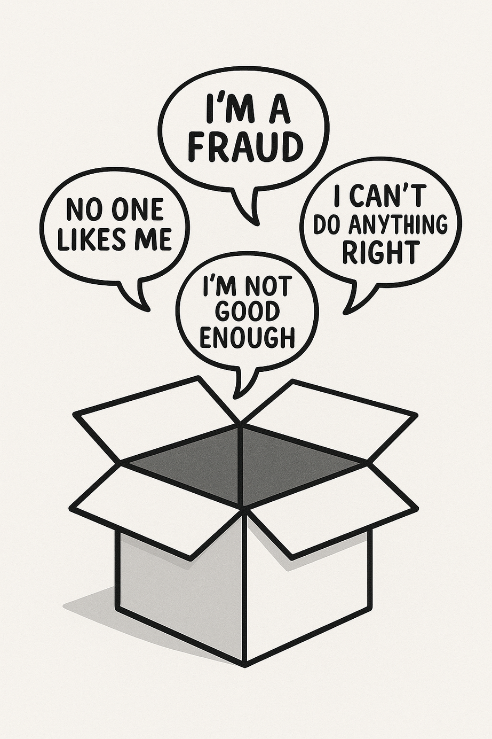
Automatic, Negative Thoughts are Called “Roadblocks”
Notes:
“What you might not realize is that you’ve been uncovering some of the negative messages your brain has been storing for a long time. Think of it like having a personal box in your mind. Inside that box are all the negative things you’ve told yourself—or that others may have told you—that you’ve started to believe over time.”
“When you feel stressed or upset, your brain automatically opens that box and pulls out one of those old thoughts. You don’t even have to think about it—it just happens. You pick the one that fits how you’re feeling in the moment.
“Here’s an example. Let’s say that your walking up a street. You notice your best friend on the other side of the street walking towards you. Your friend sees you. You don’t say anything but you wave at your friend. Your friend looks at you, doesn’t wave back, and then just continues walking past you.”
What would be the first thing you say to yourself?
Most students would respond by “my friend is mad at me”
The problem is, most of the time, you don’t stop to ask yourself whether that thought is actually true. You just accept it. What we’re learning to do here is to pause, look at that thought, and decide for ourselves if it really deserves to stay in that box—or if it’s time to throw it out.”

Slide 33
Roadblocks are usually:
Overly Black and White
Concise and Overly Definitive
All or nothing
Thought behind the moral statement or golden rule
If/then statements
Not always
“I statements”
“I didn’t make my boyfriend happy, he’s breaking up with me”
“I am a failure”
“If I don’t get all A’s, I’ll never get into college”
Not Behaviors
Thoughts, Not Feelings
It May Not Make Sense to You—But It Makes Sense to Them

Slide 34
Back to the Behavior Chain….
A (What happened?) | B (What Was I Thinking?) | C (What Was I Feeling?)
I got a pop quiz in my math class | I’m going to fail | Sadness
My Friend Made Fun of Me in Front of Others | I’m going to end this friendship | Anger
Notes:
“Now we’re going to practice recognizing that process using the A–B–C Reflection Exercise.”
(Hand out the worksheet)
“Take a few minutes to look it over. You’ll see two examples already filled in that show how A (the event) leads to B (the thought or belief), which leads to C (the feeling or outcome).
Then, you’ll come up with two of your own examples. They don’t have to be things that really happened — you can make them up if you want.
You’ll have about five minutes to write your examples, and then we’ll spend another five minutes sharing and discussing as a group.”

Slide 35
We Cannot Change This
We Automatically Change This…
But If We Challenge This…
A (What happened?) | B (What Was I Thinking?) | C (What Was I Feeling?)
I got a pop quiz in my math class | I’m going to fail | Sadness
My Friend Made Fun of Me in Front of Others | I’m going to end this friendship | Anger
ROADBLOCKS
Notes:
“Now we’re going to practice recognizing that process using the A–B–C Reflection Exercise.”
(Hand out the worksheet)
“Take a few minutes to look it over. You’ll see two examples already filled in that show how A (the event) leads to B (the thought or belief), which leads to C (the feeling or outcome).
Then, you’ll come up with two of your own examples. They don’t have to be things that really happened — you can make them up if you want.
You’ll have about five minutes to write your examples, and then we’ll spend another five minutes sharing and discussing as a group.”

Slide 36
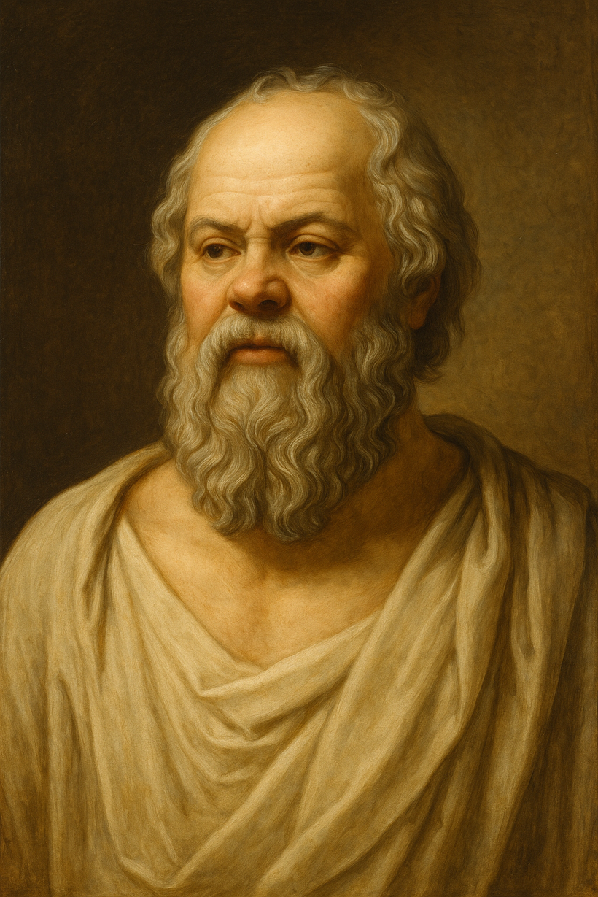
We Challenge Our Roadblocks by Looking at the Evidence

Slide 37
Back to the Behavior Chain….
We Challenge This
A (What happened?) | B (What Was I Thinking?) | C (What Was I Feeling?)
I accidently dropped my books in the hallway, holding up students trying to get to the next class | I can’t do anything right | Anger
Notes:
“Now we’re going to practice recognizing that process using the A–B–C Reflection Exercise.”
(Hand out the worksheet)
“Take a few minutes to look it over. You’ll see two examples already filled in that show how A (the event) leads to B (the thought or belief), which leads to C (the feeling or outcome).
Then, you’ll come up with two of your own examples. They don’t have to be things that really happened — you can make them up if you want.
You’ll have about five minutes to write your examples, and then we’ll spend another five minutes sharing and discussing as a group.”

Slide 38

Examining My Roadblocks Worksheet
Below is a list of questions to help you challenge your unhelpful roadblocks. Some of the questions might not be appropriate for the roadblock you choose to challenge, but you should answer as many as you can.
Roadblock:
1. What is the evidence for and against the roadblock?
Evidence for:
Evidence against:
2. What information are you not considering (or are leaving out) in your roadblock?
3. Is this a reliable source?
4. Your roadblock may be possible, but what is the likelihood of it happening?
5. What is a less-extreme scenario that might be more realistic?
Notes:
You’ve just seen how the worksheet works using two examples. Now it’s your turn to give it a try with one of your own roadblocks.
Take a look at your Roadblock Log and pick one that stands out to you. It doesn’t need to be a big one—just choose something you’re comfortable exploring.
I’ll give you about five minutes to go through the steps on your blank Examining My Roadblocks worksheet.
If you get stuck or aren’t sure how to phrase something, just do your best. This is a new skill, and like anything new, it takes practice and time to build confidence.
(after the alotted time)
“Let’s check in on how that went.”
How did that feel for you? Was the worksheet easy to work through, or did you find parts of it challenging?
Think for a moment—what part of the worksheet was the hardest for you to complete? Was it finding the evidence? Figuring out the source of your thought? Coming up with a more balanced perspective?
Would anyone be open to sharing their worksheet with the group? We can walk through it together step-by-step. And don’t worry—if you get stuck or feel unsure, I’m here to help.
(Focus on the most important part of the worksheet—Step #1: Evidence For and Against your roadblock.”
Remember what counts as evidence:
Evidence means something that actually happened. Not a feeling. Not a guess. Something that someone else could have seen or heard. If you had been there, would you have seen the same thing as the student? If yes, it’s evidence.”
Set the expectations:
Ask students to clearly connect each piece of evidence to their roadblock.
Guide them to list a 2:1 ratio of evidence against vs. evidence for.
Emphasize that quality is more important than quantity—each item should challenge the roadblock directly.
Tips for Supporting Students
If a student struggles to find “evidence against,” ask:
“Could there be another way to interpret what happened?”
“Has this happened before? Did it turn out the same way?”
“Can you think of a time where your roadblock didn’t come true?”
Red Flags to Watch For:
Entries like “Because I just feel that way” (not evidence).
Feelings or thoughts listed as facts.
Roadblocks repeated in both the “for” and “against” sections.
Fewer “evidence against” entries than required—encourage deeper reflection.
“This step is like building a case—you're both the prosecutor and the defense. Your job is to gather all the facts before you decide what to believe. The better your evidence, the more realistic your final thought will be.”

Slide 39
What the Grades 6–12 Curriculum Is Designed to Do
Teach the student to identify their roadblocks
Record their roadblocks
Challenge their roadblocks
Rephrase what they are telling themselves in the moment
Thoughts drive emotions. Emotions drive behavior.
Change the thought, change the behavior.

Slide 40
Considering Group Dynamics

Slide 41
Group Set-Up
Group Timing
Group Size
Expectation
30 minutes (preferable), but can be adjusted to a point
4-8 ideal
Starting too small, dynamic may fall apart
With larger groups you have more dynamics to manage
No one forced to provide details in group – volunteer only
Anything less than 20 minutes likely not effective

Slide 42
Group Composition
Grade Levels
Mixed grades can work, especially > 9, BUT be aware of existing group dynamics
Gender
Can be mixed, especially in older grades
Trauma Type
Geared towards generalized anxiety, but can work for other types and other conditions
Mixing grades 4-5 with younger grades not advised

Slide 43
Typical Rules
Confidentiality
Participation (both you and group members)
Attendance & Punctuality
Respectful behavior
Interactions outside of group
Complete assignments

Slide 44
Group Basics: A Brief Review
Roles
Members responsible for work of group
Your Role: create structure and facilitate group work by
finding similarities among members
Reminding maintaining group rules
monitoring engagement
Notes:
Group rules/boundaries- having group members generate and contribute to rules for the group can increase cohesion and compliance. If needed therapist can add/require rules like participation, confidentiality, punctuality. The therapist might also introduce rules for interaction of members outside of the group.
Increased focus to group level- in group formats we shift from the individual focus to topics that are shared by multiple group members. It is helpful to engage more members by having topics that are of interest or applicable to a majority.
Group members help each other to recognize problems and work through those problems, as group members increase interaction they are also engaging (decreasing avoidance), the group members are responsible for doing the work in the session and at home.
Therapist role- the therapist is present to facilitate group member interaction, monitor involvement (increase engagement with under-involved and rein in the over-involved)

Slide 45
Your Role
To teach the members how to utilize the skills
Encourage interaction
Structure
Eye contact
Check in & set agenda
Bridging Questions
(see next slide)
Use the PowerPoints and white board
Linking members with similar roadblocks (grades 6-12)
Manage personalities and group conflict
Always review out-of-session practice assignments first
Notes:
Animations should follow your talk—see the marked click points below:
Click 1: Encourage interaction:
Skills the therapist teaches – identifying thoughts and connecting them to emotions; Challenging specific stuck points; look for maladaptive patterns of thinking; generating new perspectives and then linking those to new or less intense emotional experience
Eye contact – use your gaze to draw other members into the conversation; break your gaze from the speaking member; make sure the co-therapist is doing the same.
Click 2: Bridging questions – a question that engages the group as a whole and looks for common stuck points or solutions (more details/examples on these found on slide 17).
Click 3: Linking members – make process statements that get patients talking to one another, instead of to the therapists. For example note how their reactions or emotions are similar.
Click 4: STRUCTURE
Check-in - occurs at the start of each group and is used to manage time and crisis of the week behaviors. We will discuss how to do this in Session 2
Click 5: Using the white board – draw a facsimile of the sheet you are working on for that session
To avoid becoming too didactic while using the white board, the therapist can offer to record member’s ideas
Click 6: MANAGING INDIVIDAL PERSONALITIES
This is discussed in detail in the manual , when in doubt use the model – for example do an ABC sheet on a group member’s complaint or a member’s current crisis; for the monopolizers – refer to manual session 3 for ideas
The quiet member – “I notice you listening carefully to what everyone is saying, what are you thinking?”
Group Conflict – great time to use a worksheet! If available, utilize co-therapist. Rely on the model, rather than processing the conflict – use it as a teaching moment for linking thoughts to feelings; or as a common stuck point. How you do this really depends on the specifics of the conflict, there are too many to review here, use your clinical judgment
Click 7: Reviewing between Session Practice
Group members can share verbally what they did; have them turn in their sheets after check in and co-therapist reviews and gives written feedback by the end of group; also can review sheets between sessions and give back the next week; ask participants to redo at least one sheet they got feedback on in addition to their other assignments

Slide 46
Bridging questions (esp. for grades 6-12) will:
Engage the group as a whole
Draw out comments from all
Identify common roadblocks or solutions
Suggest a common roadblock
Elicit acknowledgment of shared from members
Notes:
Animations should be used with each talking point:
Click 1: Bridging questions are an important tool that can be used to get more members involved in the group and to make sure that some are not left out while others monopolize. For example one might ask: “What do others think/feel? “
Click 2: It is important that after the you ask bridging question that you encourage responses from more than one student instead of focusing on the first person who answers.
Click 3: Sometimes it is helpful to through out some commonly held roadblocks as examples in order for members to feel more of a connection with one another.
Click 4: Examples of some common roadblocks: “It is my fault; If only I had done X, the outcome would not have happened to me (and/or others); people can’t be trusted; having anxiety is a weakness, etc.”
Click 5: Once a roadblock is verbalized by one group member, you could ask: “Does anyone else share this roadblock?; Does this sound familiar to anyone else?”

Slide 47
Final Thoughts

Slide 48
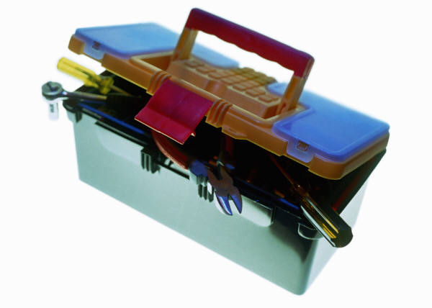
Your Commitment
Be Consistent
  Use Good Practice (be on time, be prepared, etc.)
  Guide the Meeting Using the Worksheets as Tools
Be Transparent
  Discuss concerns openly as they relate to engagement/retention
Understand the pull to get off-track
  Strong negative emotions can change the flavor of the meeting in a heartbeat
    (don’t forget to use the same skills you’re teaching the students)
  Direct challenging a roadblock may be uncomfortable for some students
    (play the “let’s try this on for size” game)
  Project confidence – You Got This!
Notes:
Be consistent
Be on time and be accountable – keep the patient on track by asking about his/her practice assignment and making sure to go through them. You asked the patient to spend time on those, so make sure you do, or they may feel you are not taking them seriously.
When issues arise in session, use the worksheets as tools so that your patients will too. The more they practice the skills, the more likely they are to feel better. Your consistency and attention to the structure of therapy will help guide the patient toward being able to eventually use these skills on their own.
Be transparent
Discuss concerns openly as they relate to engagement/retention
Remind patients of the rationale for treatment when their motivation is wavering, help identify the goal that they are working toward – this will keep them engaged

Slide 49
And last, but not least…
Don’t leave your own wisdom at the door!
  Use your good judgment, warmth, empathy – these tools are invaluable in your work
Notes:
Don’t leave your clinical wisdom at the door!
Use your good clinical judgment, warmth, empathy – these tools are invaluable in any treatment, and make any treatment more likely to be effective.
Be mindful of the protocol, try to be consistent with the skills and strategies, but do not forget

Slide 50
Questions?

