Slide 1
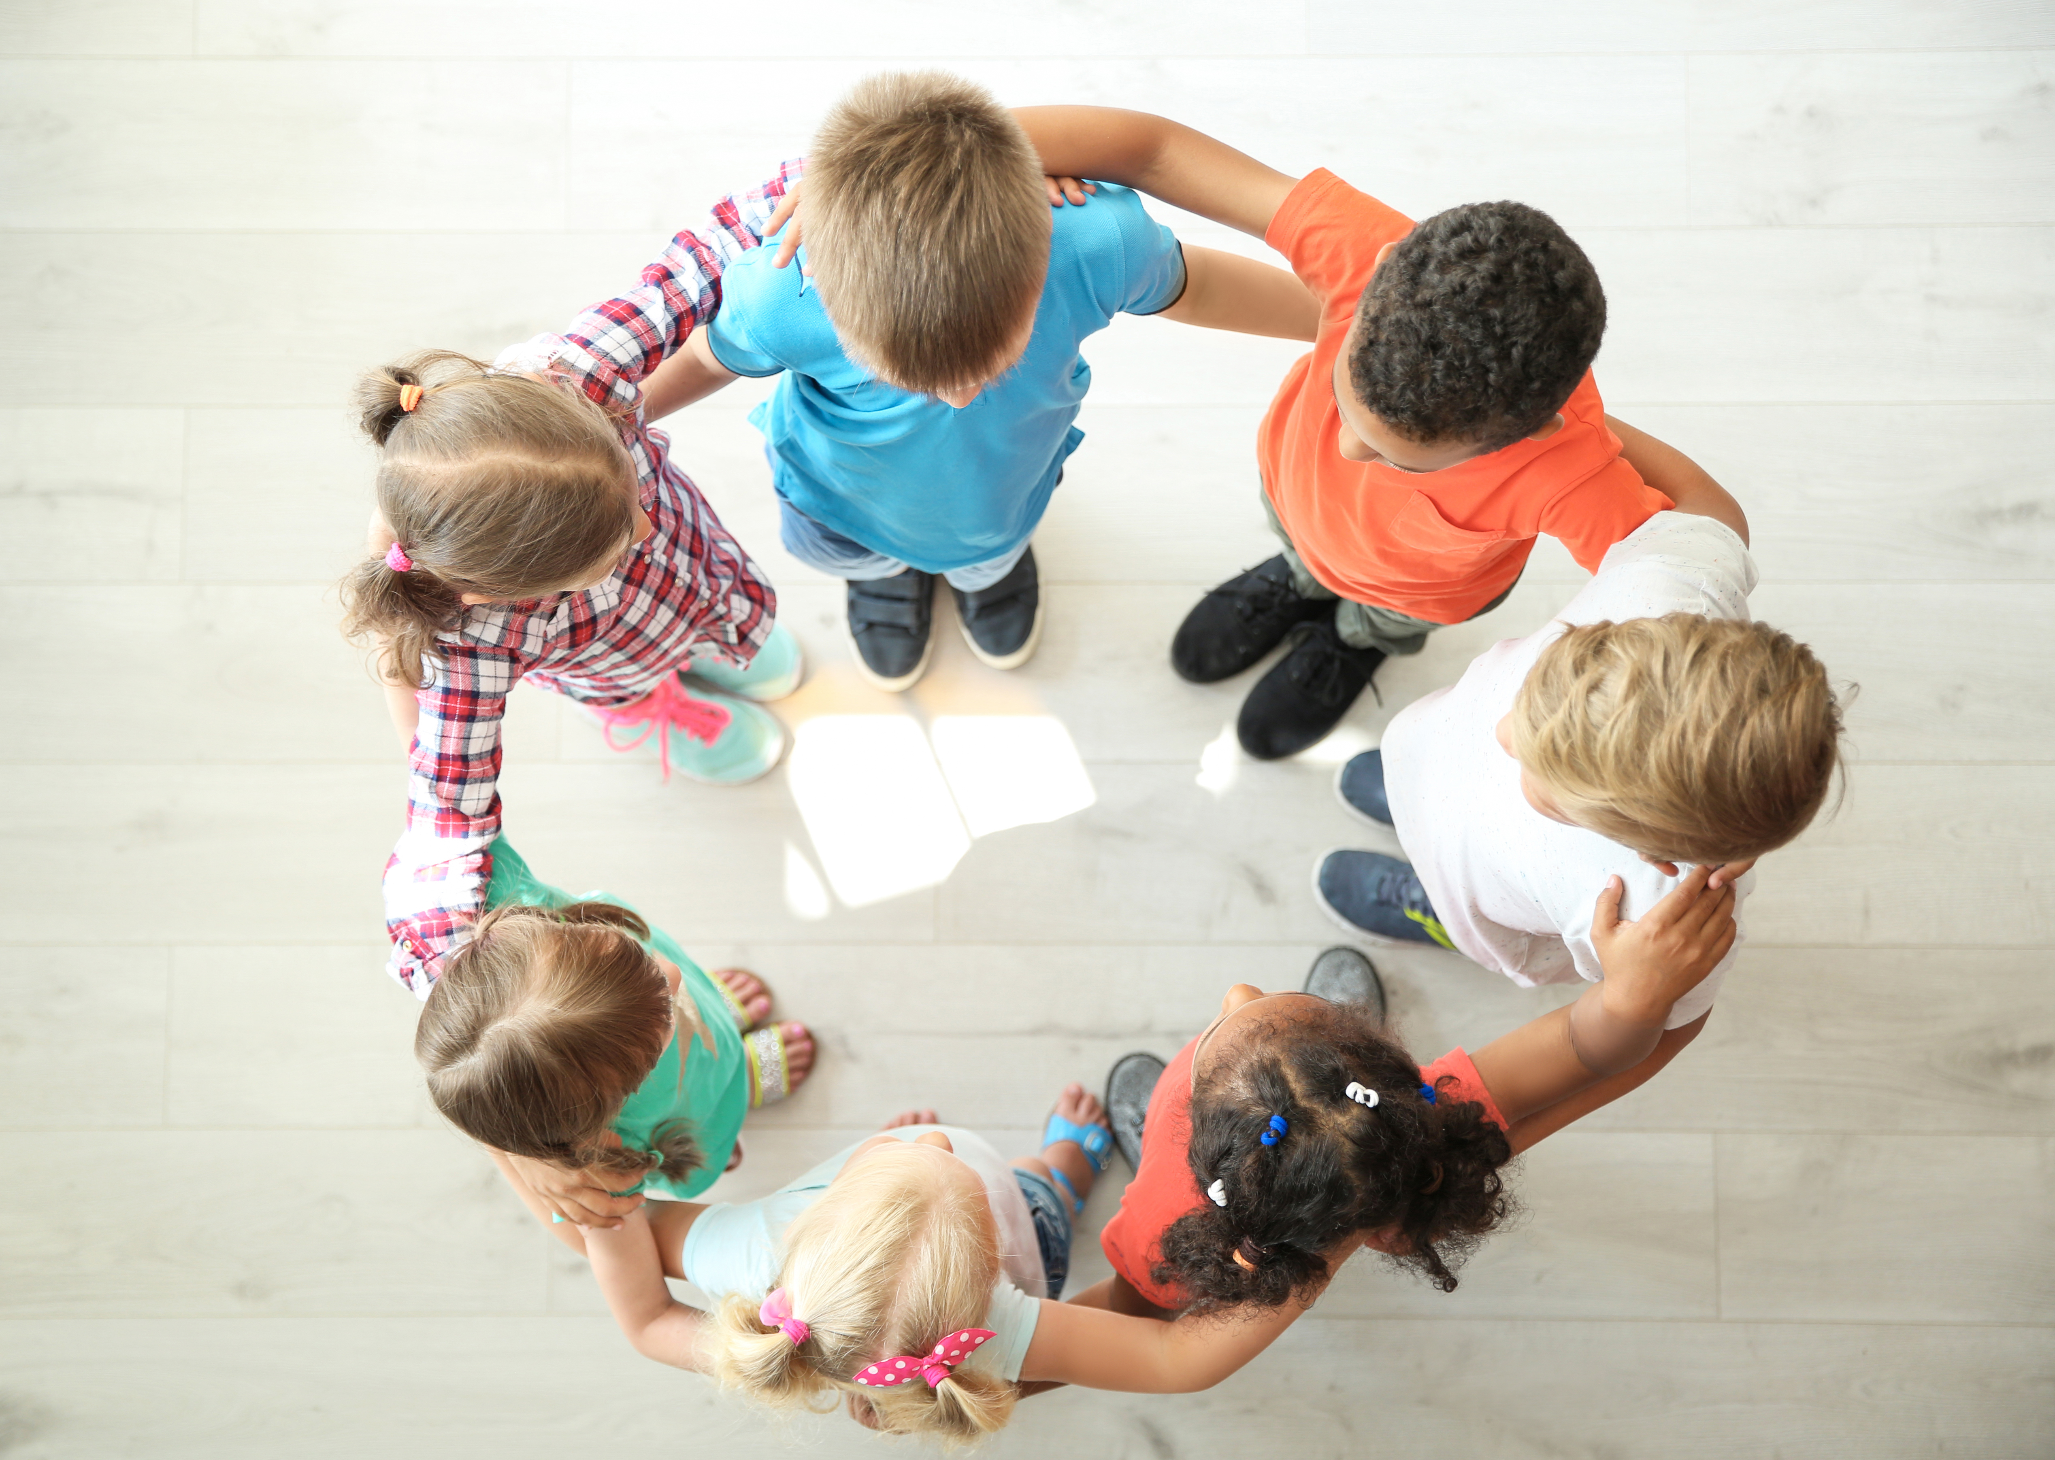
Include!
Notes:
Welcome Back! Today we are going to do our SECOND lesson about how to make our school a great place for everybody!"

Slide 2
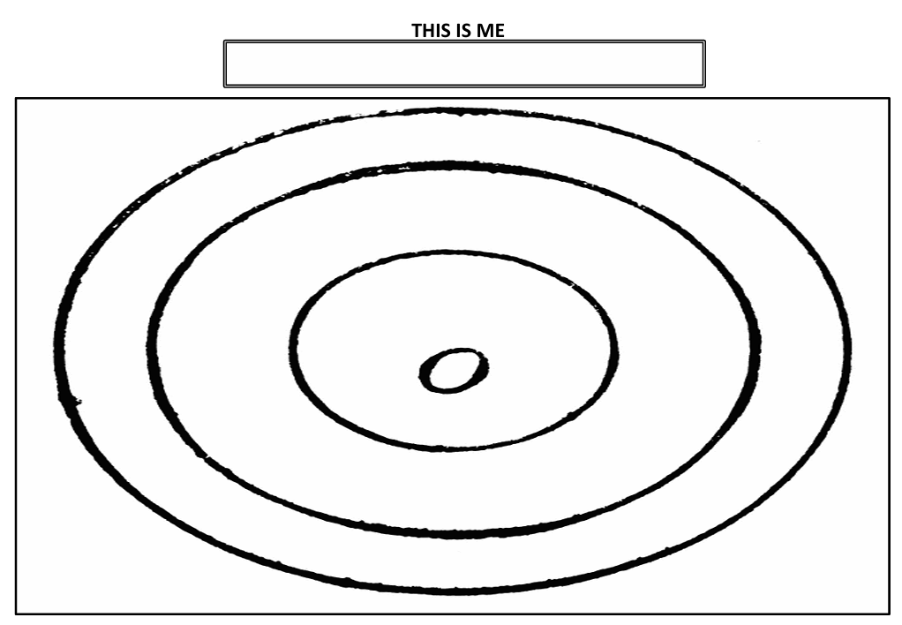
Notes:
In our last lesson, we learned that even if we are different from someone, we can still be friends — and we must always be kind to everyone, even people who are different from us."
Hold up or point to the "This Is Me" pictures still displayed in the classroom.
"Can you remember whose picture looked different from yours?

Slide 3
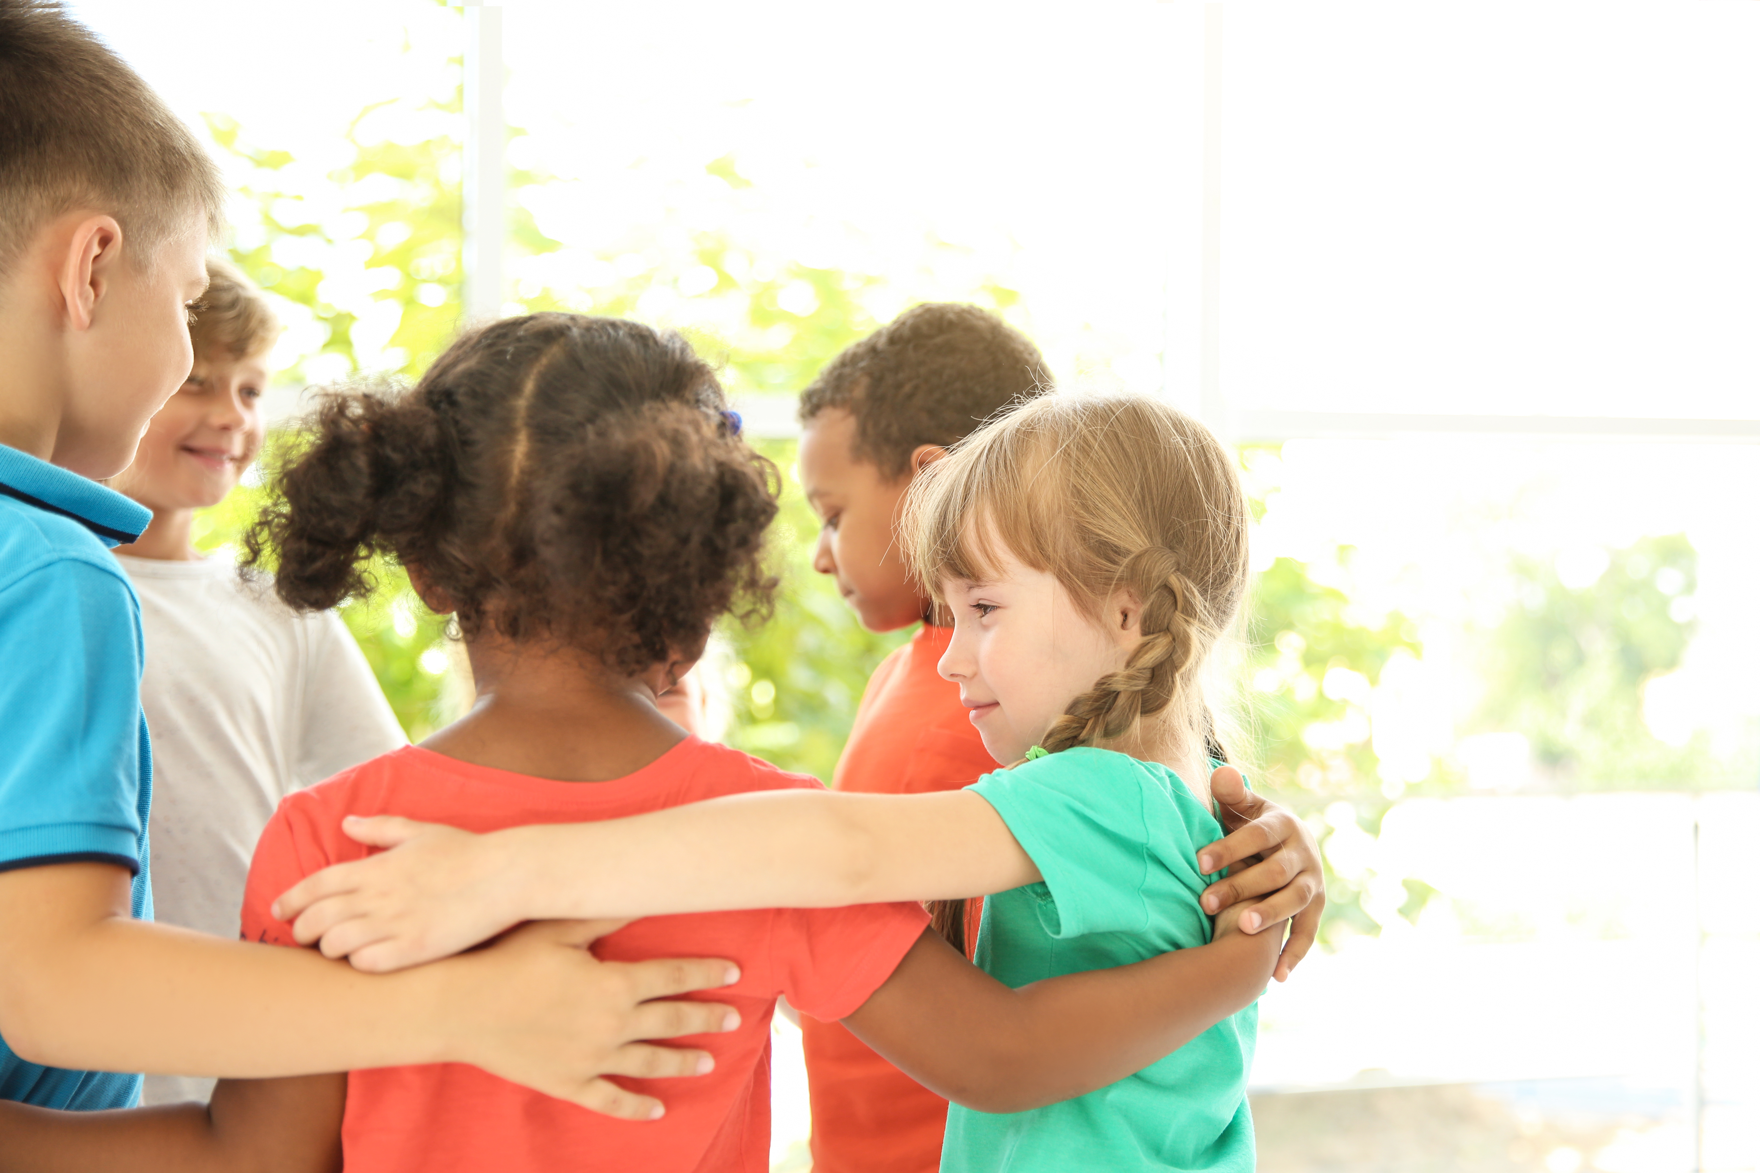
Include
https://youtu.be/bTXzYX0rrPE?si=0rly_KXtGnhxycG2
Notes:
Today we are going to learn about a very important word — INCLUDE. What do you think 'include' means?"
Allow students to respond. Look for ideas like: being part of something, joining in, not leaving anyone out. If students need help, show the video.
When we include someone, we make them feel like they belong. Today we are going to meet a boy named Milo who really needed someone to include him."

Slide 4
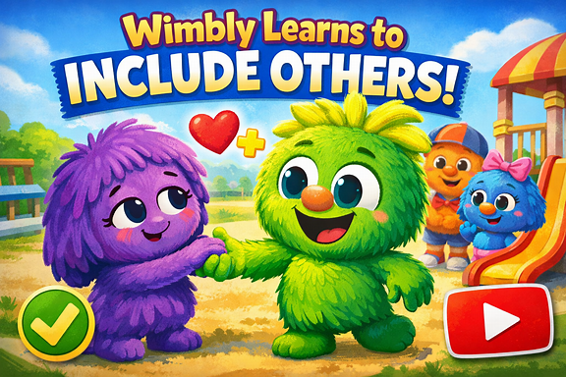
https://youtu.be/j7u7ZZ92yqQ?si=JHeIhmrX2YxY_VMD
Notes:
Today we are going to meet a boy named Milo who really needed someone to include him. Let’s watch.”
After the video is over, ask the 6 questions found on in the lesson plan.

Slide 5
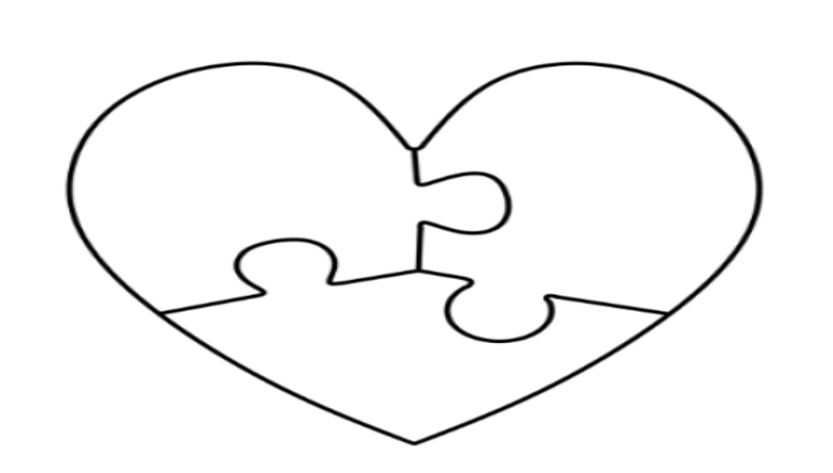
"I'm An Includer!"
Notes:
Even though Milo wasn't part of Wimbly's group, Wimbly saw Milo sitting alone. He did a very small but important act. He introduced himself and he invited Milo to play. Wimbly made Milo feel welcome and accepted. That was a very brave and kind thing to do!“
“People can make friends with anyone. You just need to be kind — just like Wimbly was.“
"Over the next few weeks, YOU are going to practice being an includer — just like Wimbly! Every time you include someone or make someone feel special, you are making our school a better place for everybody."
Give each student one "I'm An Includer" handout. Read the handout aloud together before students take it home. Make sure they understand what an "including" act looks like. Give students 2–3 simple examples of including acts they might do: "You could invite someone to sit with you at lunch, ask someone to play with you at recess, or say something kind to someone who looks sad.“
For students who are not yet writing independently, allow them to draw a picture of their including act instead of writing. You or a helper can add a label. The heart puzzle still goes on display — every act of kindness counts!

Slide 6
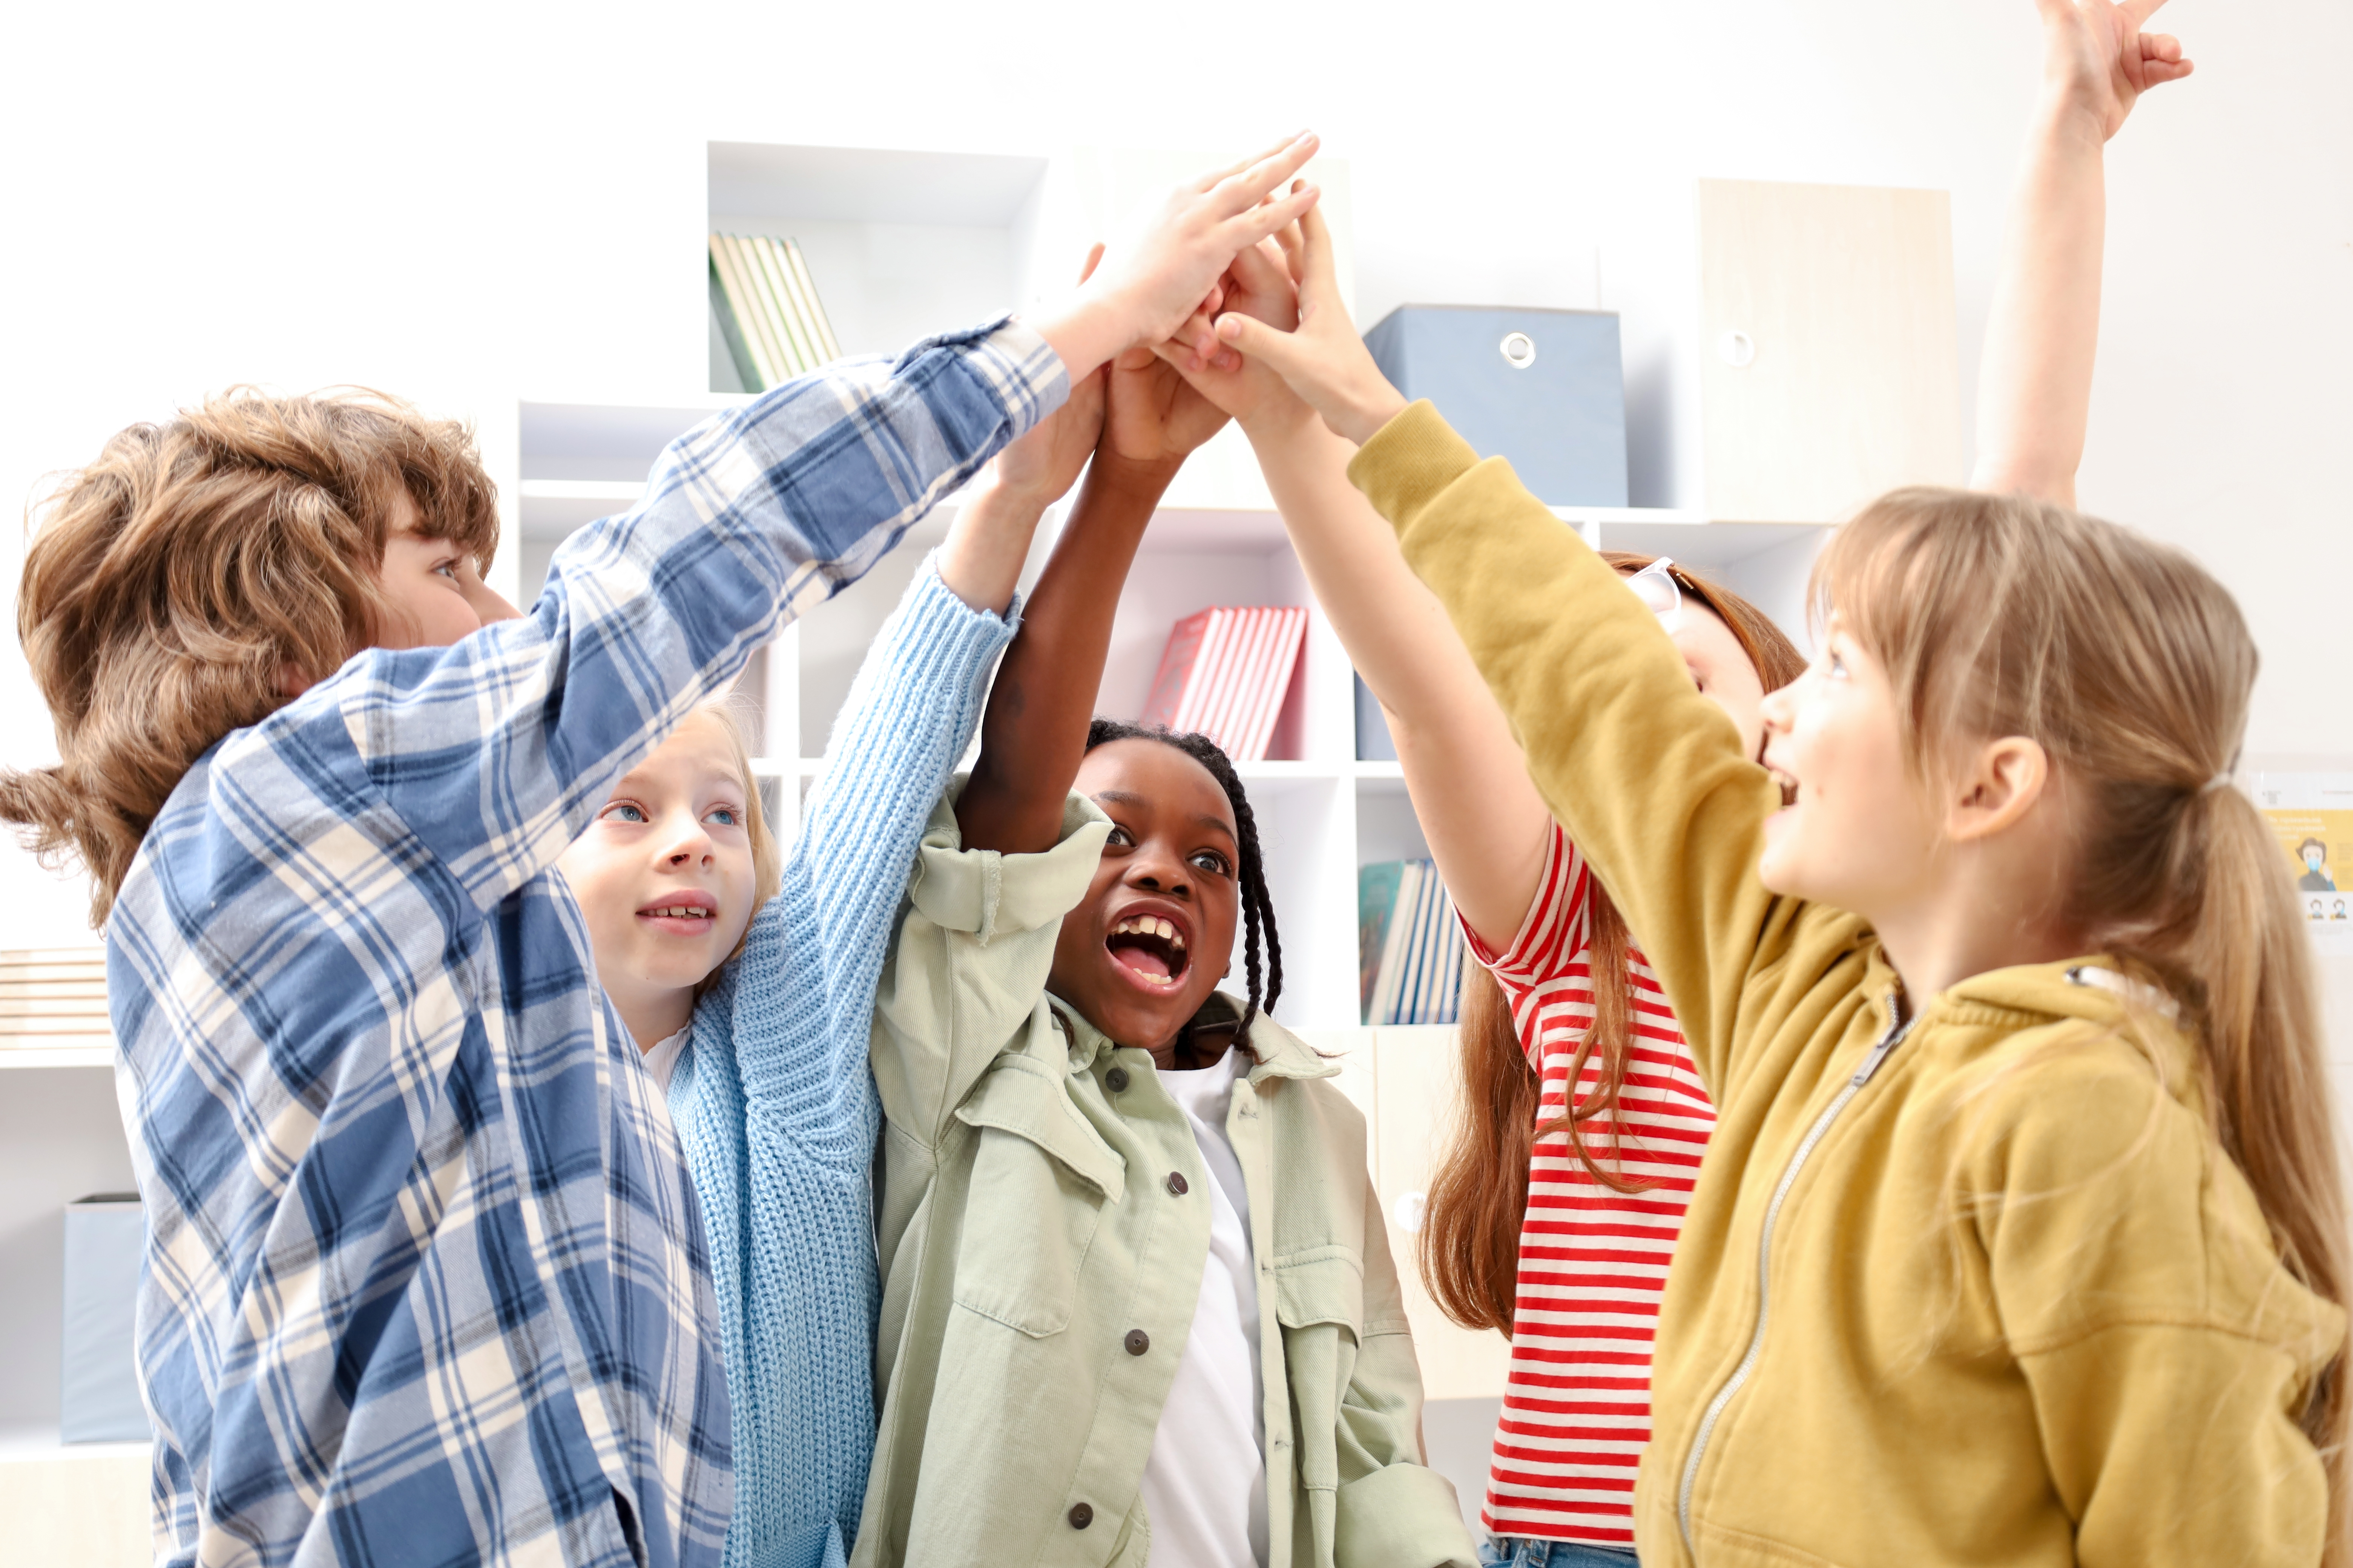
What We Learned
Notes:
Choose one or more of the following scripts, and use an enthusiastic, affirming tone to leave students feeling proud and motivated:
“If your friend group changes, you can find new friends by being an includer — just like Wimbly did. Being kind and welcoming opens the door to wonderful new friendships!“
“When we include others, our whole school becomes a happier, kinder place. Every single person — including YOU — has the power to make school great for everybody, every day.“
"When you include someone, THEY feel happy — and YOU feel happy too! Being an includer is one of the best things you can do for yourself and for the people around you."
"Being a good friend and an includer takes practice — but it's worth it! We may miss out on a wonderful friendship if we only spend time with people we already know. Let's keep trying!"

